Slide 1
Gradient Descent

Slide 2
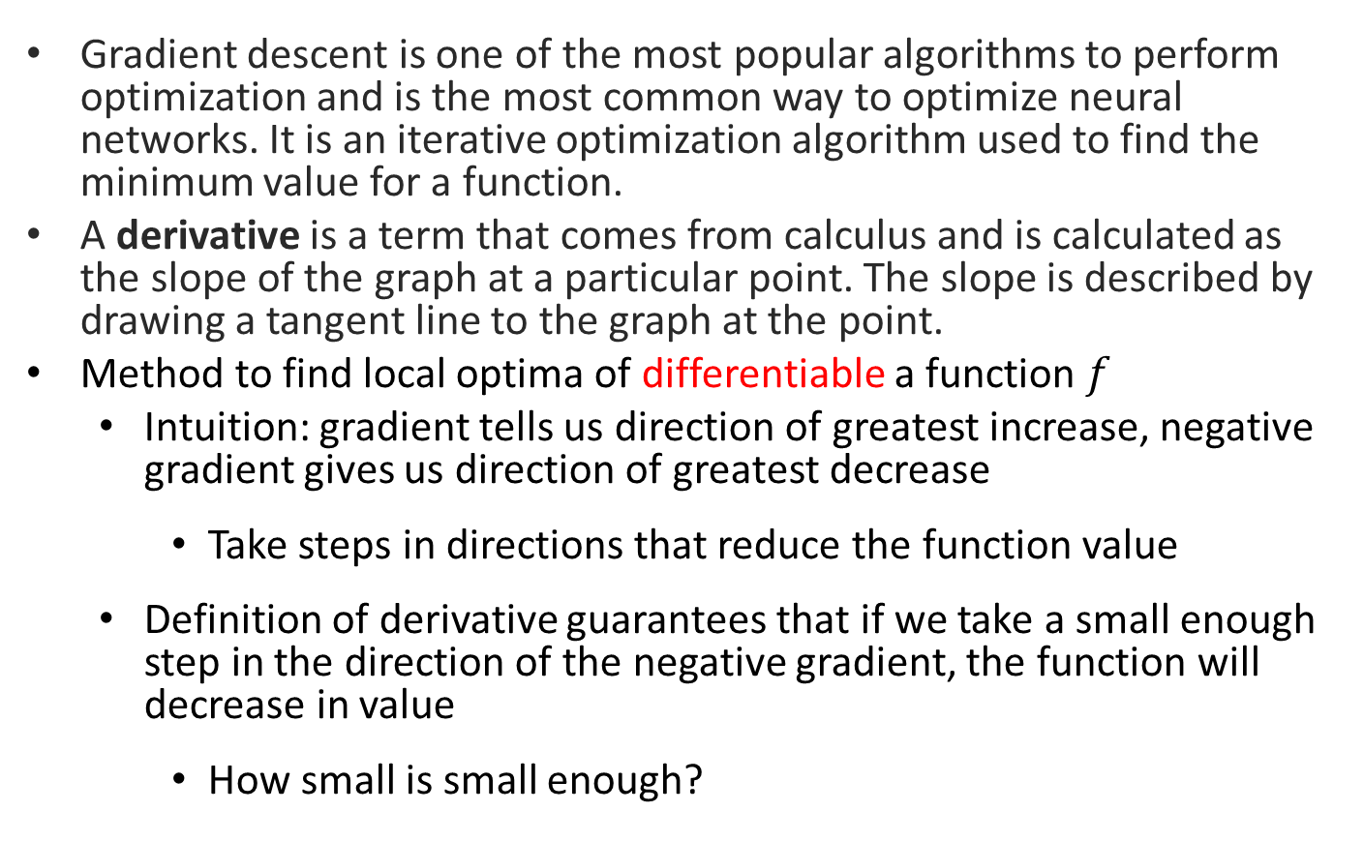
Gradient Descent
Gradient descent is one of the most popular algorithms to perform optimization and is the most common way to optimize neural networks. It is an iterative optimization algorithm used to find the minimum value for a function.
A derivative is a term that comes from calculus and is calculated as the slope of the graph at a particular point. The slope is described by drawing a tangent line to the graph at the point.
Method to find local optima of differentiable a function $f$
Intuition: gradient tells us direction of greatest increase, negative gradient gives us direction of greatest decrease
Take steps in directions that reduce the function value
Definition of derivative guarantees that if we take a small enough step in the direction of the negative gradient, the function will decrease in value
How small is small enough?

Slide 3

Gradient Descent
Gradient Descent Algorithm:
Pick an initial point $x_{0}$
Iterate until convergence
$$x_{t+1}=x_{t}−γ_{t}∇f(x_{t})$$
where $γ_{t}$ is the $t^{th}$ step size (sometimes called learning rate)

Slide 4
Gradient Descent
Gradient Descent Algorithm:
Pick an initial point $x_{0}$
Iterate until convergence
$$x_{t+1}=x_{t}−γ_{t}∇f(x_{t})$$
where $γ_{t}$ is the $t^{th}$ step size (sometimes called learning rate)
When do we stop?

Slide 5


Gradient Descent
Gradient Descent Algorithm:
Pick an initial point $x_{0}$
Iterate until convergence
$$x_{t+1}=x_{t}−γ_{t}∇f(x_{t})$$
where $γ_{t}$ is the $t^{th}$ step size (sometimes called learning rate)
Possible Stopping Criteria: iterate until $\left\|∇f(x_{t})\right\|≤ε$ for some $ε>0$
How small should $ε$ be?

Slide 6
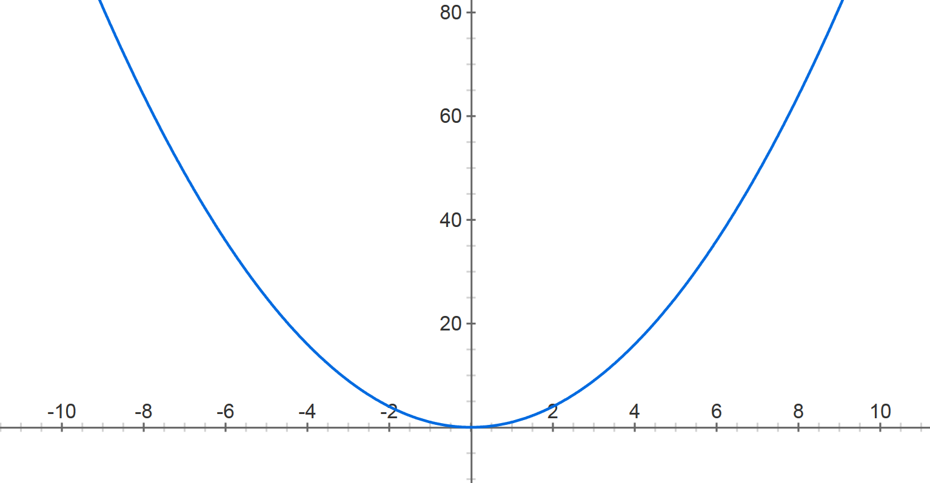



Gradient Descent
$$f\left(x\right)=x^{2}$$
Step size: $.8$
$$x^{(0)}=−4$$

Slide 7


Gradient Descent
$$f\left(x\right)=x^{2}$$
Step size: $.8$
$$x^{(0)}=−4$$
$$x^{(1)}=−4− .8⋅2⋅(−4)$$

Slide 8

Gradient Descent
$$f\left(x\right)=x^{2}$$
Step size: $.8$
$$x^{(0)}=−4$$
$$x^{(1)}=2.4$$

Slide 9



Gradient Descent
$$f\left(x\right)=x^{2}$$
Step size: $.8$
$$x^{(0)}=−4$$
$$x^{(1)}=2.4$$
$$x^{(2)}=2.4− .8⋅2⋅2.4$$
$$x^{(1)}=0.4$$

Slide 10

Gradient Descent
$$f\left(x\right)=x^{2}$$
Step size: $.8$
$$x^{(0)}=−4$$
$$x^{(1)}=2.4$$
$$x^{(2)}=−1.44$$

Slide 11





Gradient Descent
$$f\left(x\right)=x^{2}$$
Step size: $.8$
$$x^{(0)}=−4$$
$$x^{(1)}=2.4$$
$x^{(2)}=−$1.44
$$x^{(3)}=.864$$
$$x^{(4)}=−0.5184$$
$$x^{(5)}=0.31104$$
$$x^{(30)}=−8.84296e−07$$

Slide 12
Gradient Descent
Step size: .9

Slide 13
Gradient Descent
Step size: .2

Slide 14
Gradient Descent
Step size matters!

Slide 15
Gradient Descent
Step size matters!

Slide 16
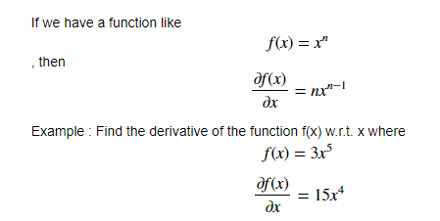
Derivatives
Machine learning uses derivatives in optimization problems. Optimization algorithms like gradient descent use derivates to decide whether to increase or decrease the weights to increase or decrease any objective function. If we are able to compute the derivative of a function, we know in which direction to proceed to minimize it. Primarily we shall be dealing with two concepts from calculus : Power Rule- Power rule calculates the derivative of a variable raised to a power.

Slide 17

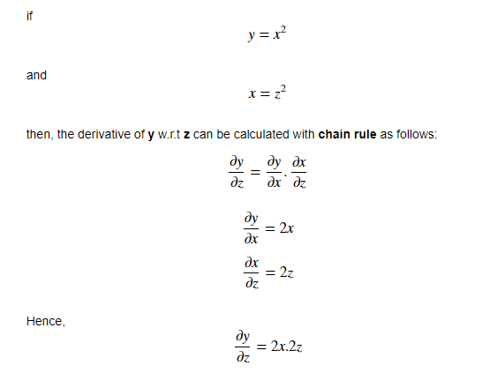
Chain Rule
The chain rule is used for calculating the derivative of composite functions. The chain rule can also be expressed in Leibniz’s notation as follows:

Slide 18
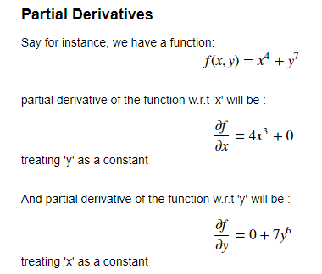
Partial derivatives, which says that if there is a function of two variables, then to find the partial derivative of that function w.r.t to one variable, treat
the other variable as constant. Example

Slide 19
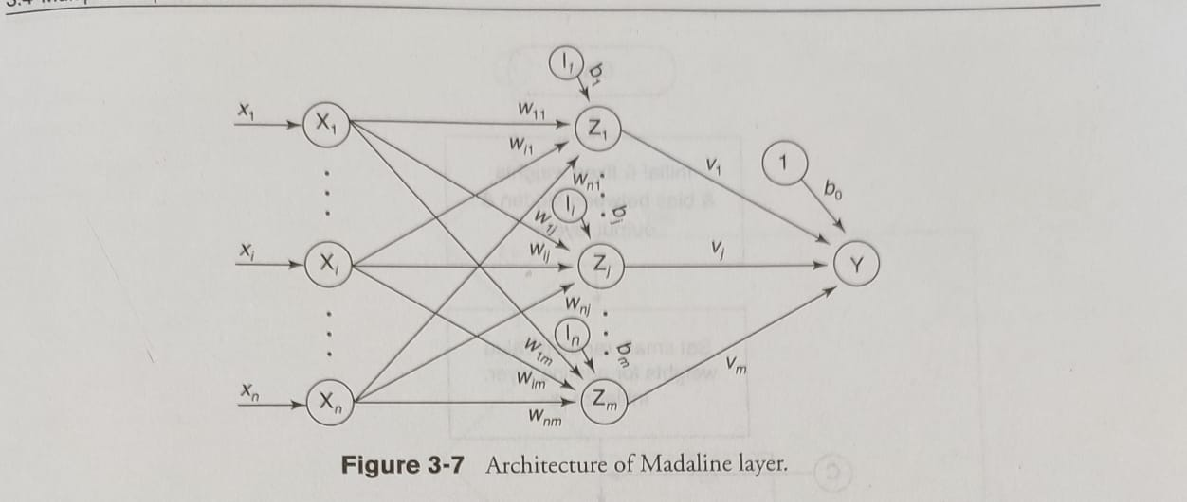
MADALINE

Slide 20
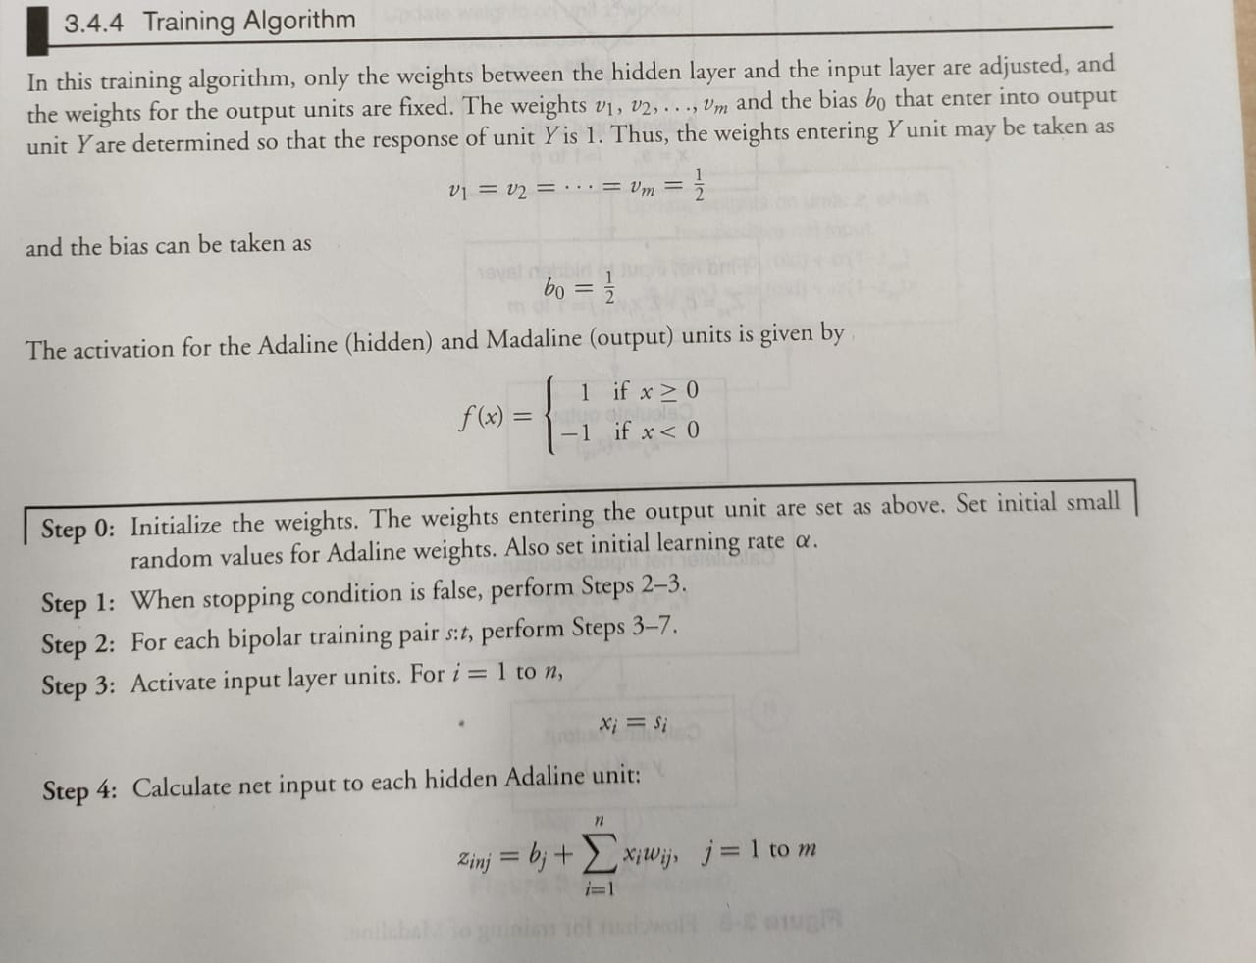

Slide 21
